Slide 1
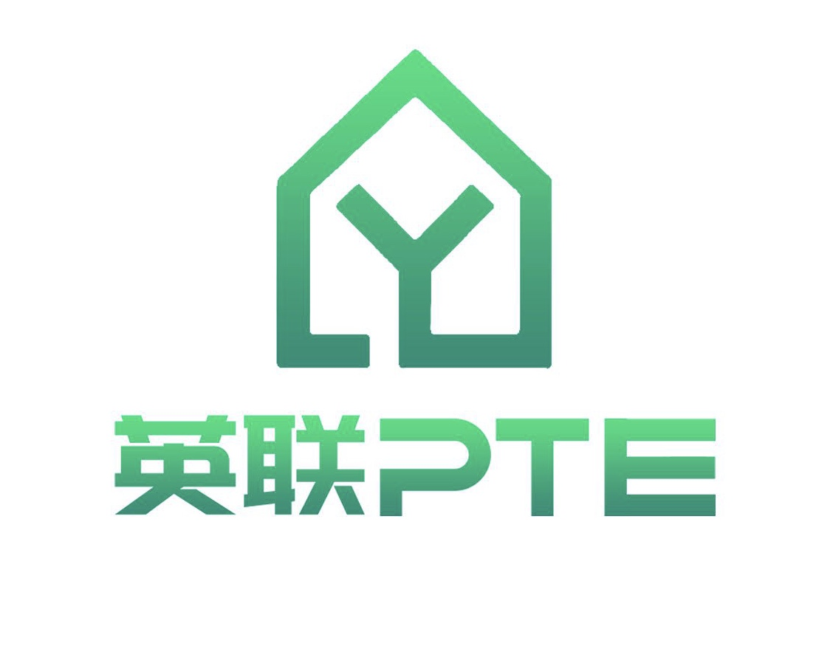
PTE 从入门到学废 ——Read Aloud 篇
英联PTE
By 传说中的Solidus

Slide 2
雅思和PTE口语的区别
雅思：
测试内容少，强调临场发挥，参杂考官主观评分
PTE：
测试内容多，有技巧和应对AI识别套路，容易出分

Slide 3
口音真的重要吗？
在雅思中：Yes
口音会影响考官的评分标准，无论是主观还是潜意识
在PTE中：Not Really
AI识别程度，流利度识别
PS：冲7的话要注意流利度，冲8的话要注意流利度和发音

Slide 4
跟读训练
Scientists have developed a new technique for rejuvenating skin cells. This technique has allowed researchers to rewind the cellular biological clock by around 30 years according to molecular measures, significantly longer than previous reprogramming methods. The partially rejuvenated cells showed signs of behaving more like youthful cells in experiments simulating a skin wound. This research, although in early stages, could eventually have implications for regenerative medicine, especially if it can be replicated in other cell types.
Reference: ScienceDaily. (n.d.). Old skins cells reprogrammed to regain youthful function: Findings could lead to targeted approach for treating aging. [online] Available at: https://www.sciencedaily.com/releases/2022/04/220408083901.htm.

Slide 5
总结
冲7的同学：
每天练机经，一天至少5段
冲8的同学：
每天机经5段，Science Daily的Abstract 至少5段
Web： www.sciencedaily.com

